Slide 1
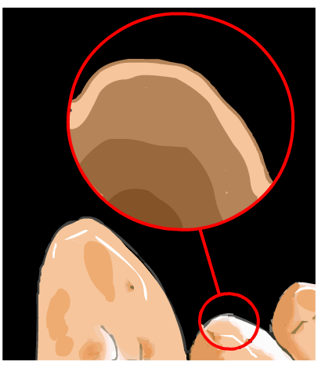
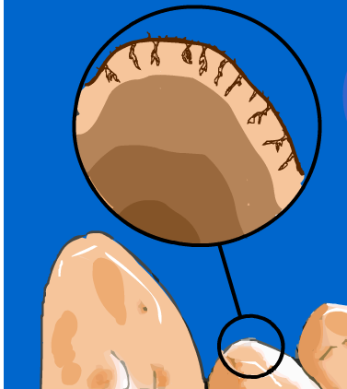
Physical weathering
Temperature change
Solids expand when they are heated, and contract when they are cooled.
Day: hot temperature, rocks expand
Night: temperature drops quickly, rocks contract
As the rocks contract, this causes cracks and rock pieces can break off.

Slide 2
What will happen to a glass bottle containing a liquid if it is left in a freezer for too long?

Slide 3
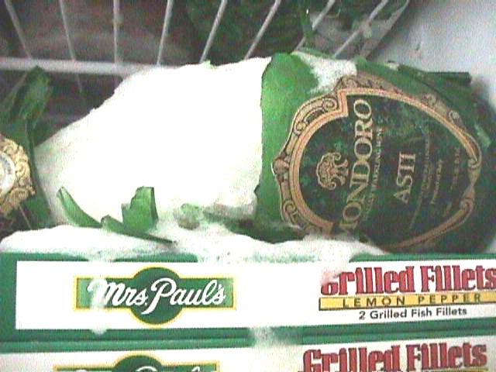
The liquid inside the bottle expands as it freezes.
The ice formed creates huge forces on the glass, which then cause the bottle to break.
It shatters!

Slide 4
Physical weathering
Action of water and ice
Ice can split rocks by cooling them rapidly.
Ice also widens cracks in rocks, since water expands as it freezes.

Slide 5
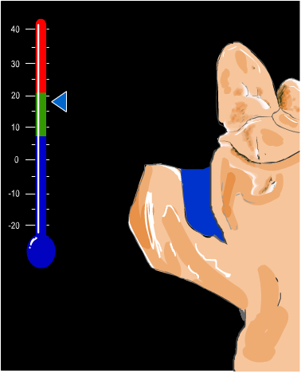
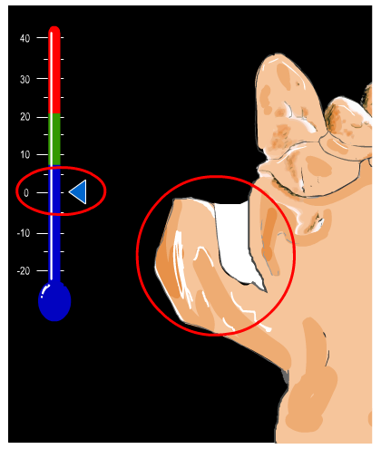

Slide 6
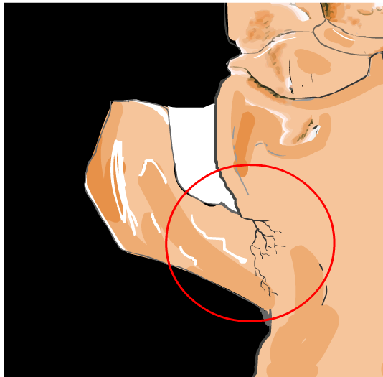
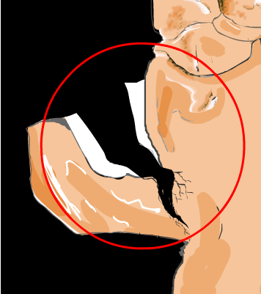

Slide 7
Physical weathering
Crystallisation of salts
Water in the soil naturally contain dissolved salts, which form crystals as the water evaporates.
If the crystals form inside a rock, then the expanding crystals can put pressure on the rock and cause pieces to break off.

Slide 8
Physical weathering
Wind
Fine particles of rock in the wind can blast the rock surface, wearing pieces away.
Living plants
Plants can grow through fine cracks of rock, and as the plant continues to grow, roots can break off pieces of rock.

Slide 9
Chemical weathering
Gases
Air contains oxygen and carbon dioxide. These can react with certain rock types, changing the chemical make up of the rock.
Often causes the rock to crumble, as well as change colour.
Acids
Rainwater contains dilute acids that can attack rock.
Pollution in the air combines with rainwater to form acid rain, which breaks down rock faster.

Slide 10
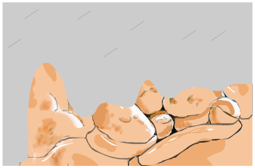
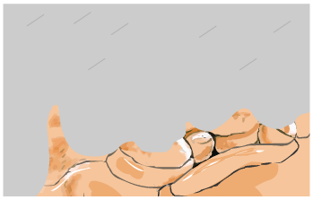
Slow chemical weathering
Rapid chemical weathering

Slide 11
Chemical weathering
Water
Some rocks have soluble materials in them.
Rain and running water can dissolve these materials, removing the ‘cement’ that holds the rock together, making it crumble.

